Slide 1

The Path of Data-Driven Decision Making

Slide 2
How do health and housing fit together in North Texas?
Asthma
Housing
Asthma is the largest contributor to chronic poor health among children in North Texas
Indoor asthma triggers are a large contributor to asthma severity
Asthma can be successfully managed with the right support and with indoor trigger management
Poor housing conditions drive poor asthma outcomes
In North Texas, mold and rodents are the largest housing related drivers of uncontrolled childhood asthma
Leaky plumbing, indoor gas heaters, exposure to the outside and unmoderated temperature also trigger asthma

Slide 3
What databases exist already to assess childhood asthma and housing?
Database | Indicator
Dallas Forth Worth Hospital Council | Asthma Emergency Room Visits
Children’s Health 2015 Community Health Survey | Asthma Prevalence; Asthma Control
Dallas Central Appraisal District | Housing Quality metrics
How do we connect data from these different sources?
Zipcodes

Slide 4
Crosswalk of Zipcodes with Metrics
 | Current asthma: Top 10 Zipcodes | Asthma Emergency Room Visits: Top 10 Zipcodes | Poor or very poor housing quality: Top 10 Zipcodes | Population Under 18 y.o.
75040 | Y |  |  | 17574
75052 | Y | Y |  | 27720
75060 | Y |  |  | 14839
75115 |  | Y |  | 12677
75104 |  | Y |  | 13689
75149 | Y |  |  | 18163
75150 | Y |  |  | 16137
75203 |  |  | Y | 4544
75206 |  |  | Y | 4282
75208 |  |  | Y | 8651
75211 | Y | Y | Y | 24074
75212 |  |  | Y | 8605
75214 |  |  | Y | 6498
75216 | Y | Y | Y | 14484
75217 | Y | Y | Y | 28338
75223 |  |  | Y | 3287
75224 |  |  | Y | 11226
75227 | Y | Y | top20 | 19138
75228 |  | Y |  | 21434
75241 |  | Y |  | 8105
75243 | Y | Y |  | 14943
This neighborhood is part of an existing strategic growth plan for the City of Dallas

Slide 5
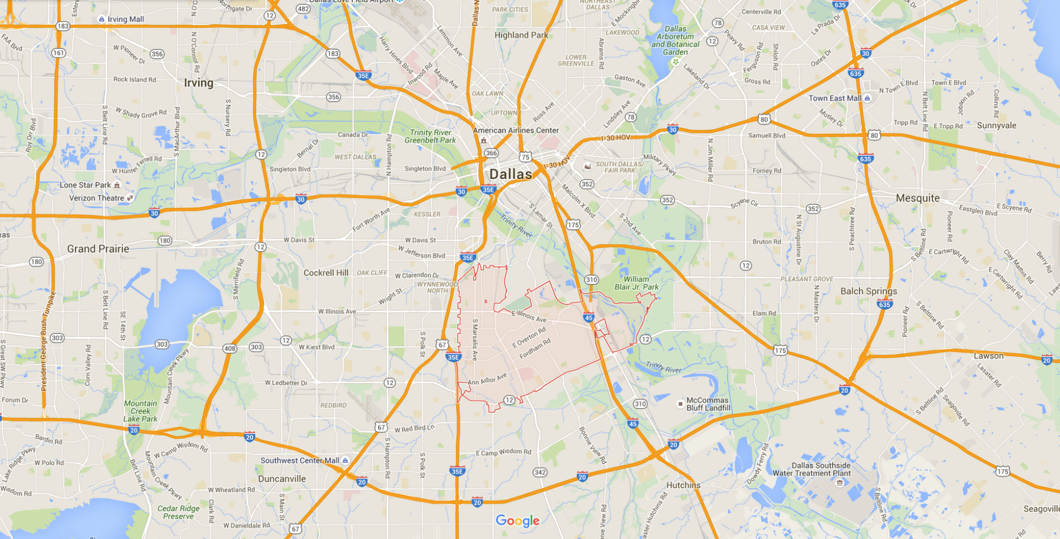
Preliminary Geographic Target Area
75216

Slide 6
Checking assumptions

Slide 7
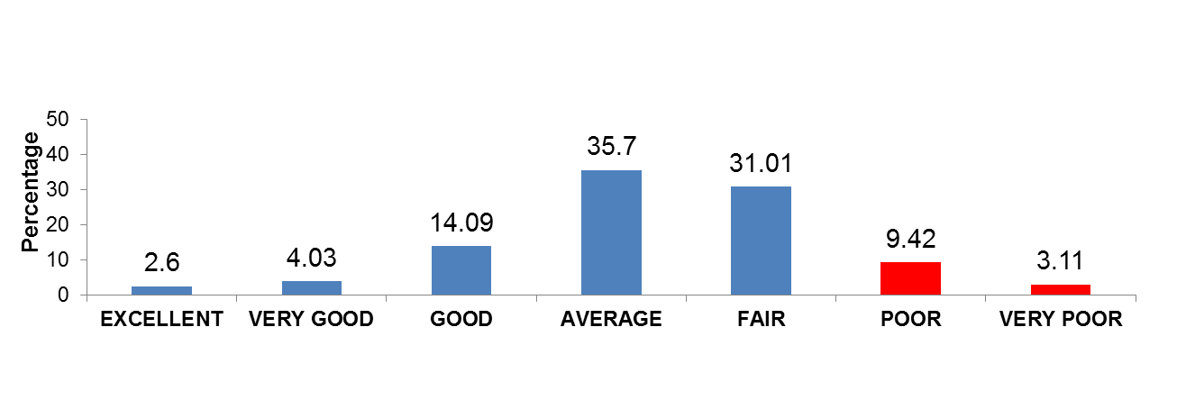
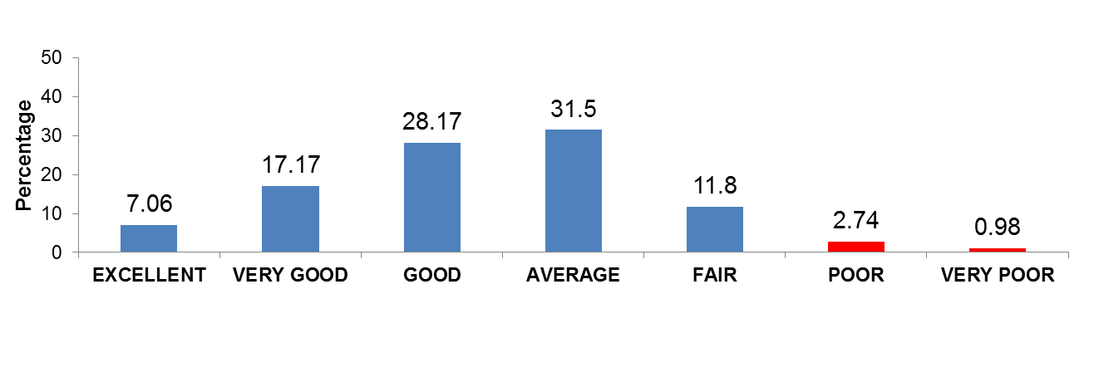
Conditions/Desirability/Utility CDU Rating
75216
Dallas County
Data Source: http://www.dallascad.org/DataProducts.aspx
2015 Certified Data files with supplemented changes

Slide 8
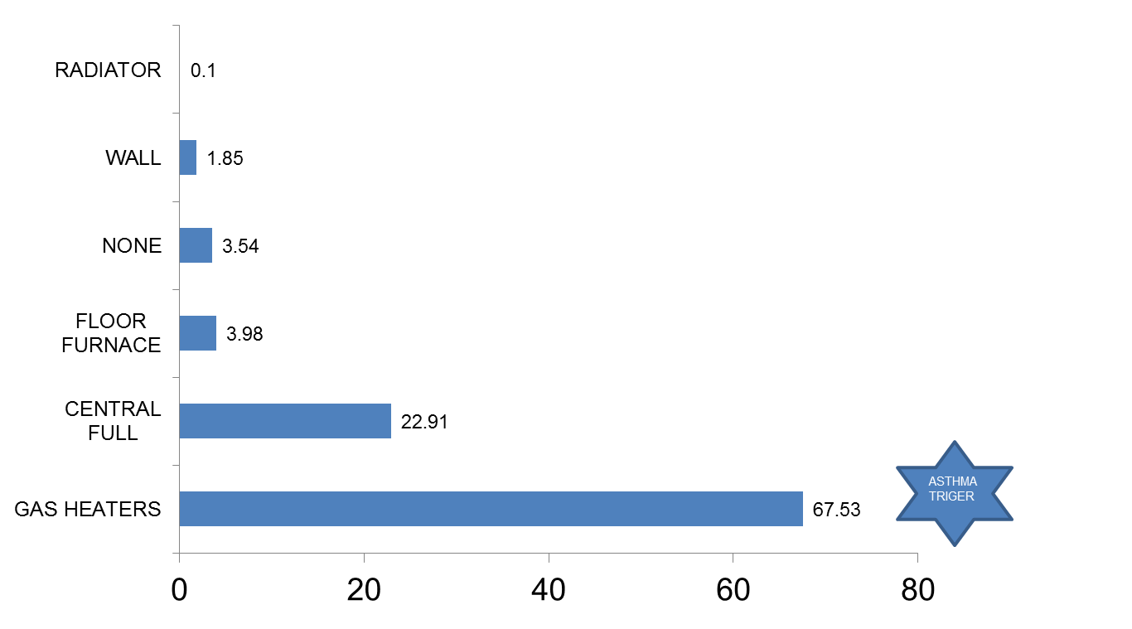
Heating type of “Poor” and “very Poor” Rating-75216
Data Source: http://www.dallascad.org/DataProducts.aspx
2015 Certified Data files with supplemented changes

Slide 9
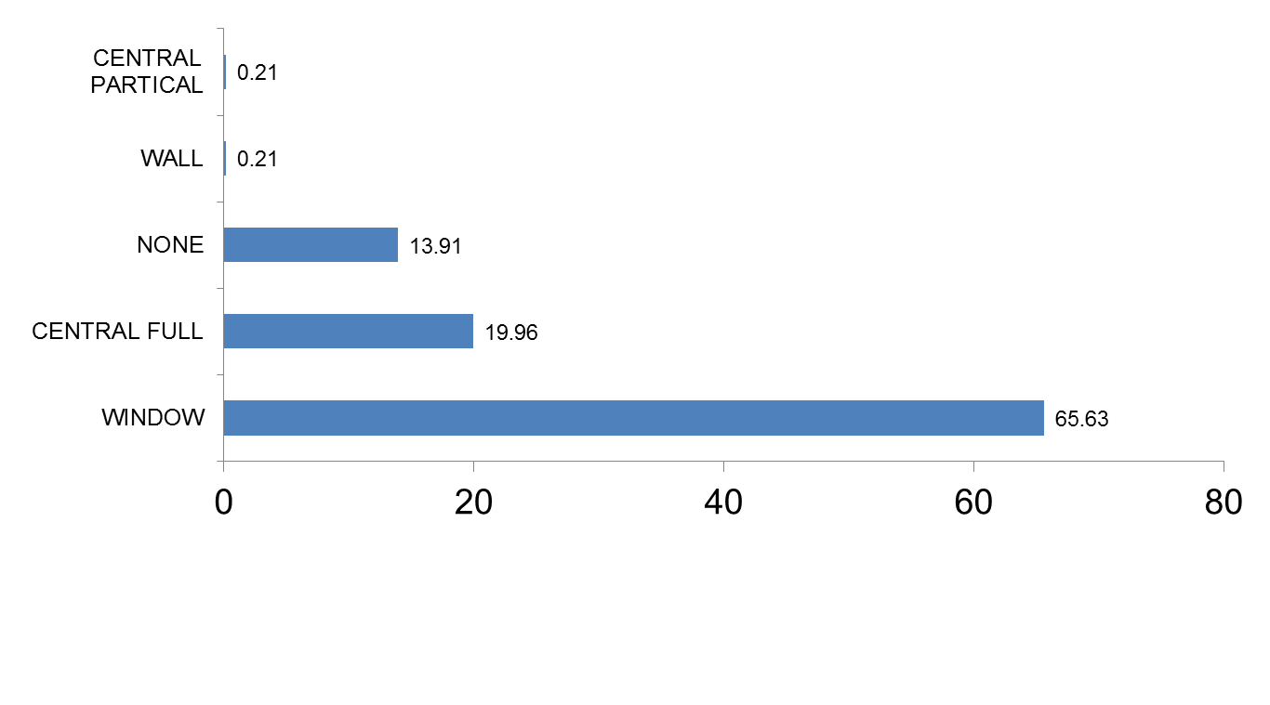
AC type of “Poor” and “very Poor” Rating-75216
Data Source: http://www.dallascad.org/DataProducts.aspx
2015 Certified Data files with supplemented changes

Slide 10
House renovations- 75216
ONLY 1.5 % houses have been renovated
ONLY 3 % renovated houses were rated as “Poor” or “Very Poor”.

Slide 11
a manageable size for intervention

Slide 12

Narrowing Area Further
Census tracts are still large but they are the smallest area for which we have reliable data
Because we only have asthma data at the zipcode level, we have to use different metrics to identify target census tracts
Chose to focus on programmatic and partner needs
Existing home repair programs only work with homes that are owner-occupied.
75216 is 14.6 square miles

Slide 13
Owner Occupancy Rates for 75216
Notes:
ACS 2014 5 year estimates

Slide 14
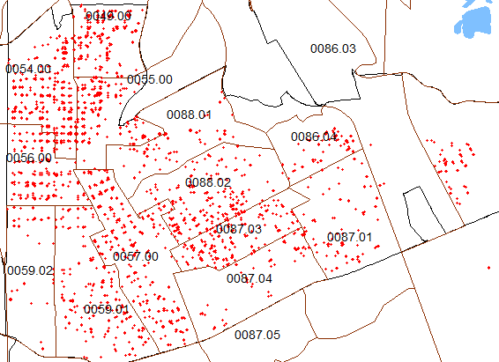
Census Tracts with High Proportion of Poor/Very Poor Housing
CENSUS_TRACT | Count of Poor/Very poor Housing
5400 | 311
5700 | 233
5500 | 180
8802 | 168
4900 | 164
5901 | 163
8703 | 150
5600 | 148
8701 | 76
8604 | 63
8704 | 49
8801 | 48
20200 | 45
5902 | 29
8603 | 3
11200 | 3
If the intervention targets “5400” and “5700” census tracts, then it would address 30 % of poor or very poor housing

Slide 15
Approx. Sample Size for Intervention
 | 5400 | 5700
# of households | 1555 | 1404
# of population under 18 | 1735 | 1169
# of population 5 to 11 years old | 589 | 591
15 % current asthma with active symptoms | 88 | 89
% owner-occupied | 54 | 57
Notes:
ACS 2014 5 year estimates

Slide 16
Working with existing programs

Slide 17
City of Dallas Programs
Major Systems Repair- up to $20,000; own home; no age limit; 80% or below of area median family income
Emergency Repairs- up to $7,500; own home; 60 yrs. or older or disabled; 80% or below of area median family income
People Helping People- volunteer work; external work;own home; 62 yrs.or older or disabled; 50% or below of area median family income
Reconstruction- Same as Major Systems Repair plus repairs exceed limits; own home; 62 yrs.or older; 80% or below of area median family income; no liens on home
Warranty- last resort situations up to $2,000; own home; 80% or below of area median family income
City of Dallas Housing/Community Services Department, http://dallascityhall.com/departments/housingcommunityservices/Pages/default.aspx

Slide 19
City of Dallas Programs
Land Bank- Newly Constructed homes on vacant property
Mortgage Assistance- up to $20,000 to assist homebuyer with down payment, closing costs, and principal reduction
City of Dallas Housing/Community Services Department, http://dallascityhall.com/departments/housingcommunityservices/Pages/default.aspx

Slide 21
Dallas Area Habitat for Humanity
Programs
A Brush With Kindness – Exterior repairs for owner occupants; low monthly income of about $1,100; large proportion are elderly or disabled
LEED Standard New Home Construction
Dallas Area Habitat for Humanity, www.dallasareahabitat.org

Slide 22
Dallas Area Habitat for Humanity
Benefits
Family Impact
  Asset building
  Financial management skills
  Address housing needs
    Overcrowding
    Poor conditions
    Cost burden
  Break rent/move cycle
  Child outcomes
Dallas Area Habitat for Humanity, www.dallasareahabitat.org

Slide 23
Dallas Area Habitat for Humanity
Financial Impact
Partner families have over $27 million in home equity
2013 Habitat Homeowner Survey

Slide 24
Dallas Area Habitat for Humanity
Child Outcome
Change Since Moving Into Habitat Home: Children Over Age Five
2013 Habitat Homeowner Survey

Slide 25
Rebuilding Together Greater Dallas
Programs
Safe at Home – Repairs for North Texas homeowners in need; typically over the age of 65, disabled, living with children (under 18) in the home, or veterans; common projects include small improvements to ensure accessibility throughout the home; more critical repairs may include flooring repairs, security improvements, minor plumbing and electrical work
REO Program – Foreclosed properties are rehabilitated and sold to low-income home buyers
Rebuilding Together Greater Dallas, www.rebuildingdallas.org

Slide 26
summary

Slide 27
Data analysis
Check with partners about existing resources
Defined programmatic goal
Analyze health and housing data together
Determine preliminary target area with greatest need
Are there existing programs within the target area that can be leveraged?
Does the population in the target area match the requirements for existing programs (ie, homeowners vs. renters)?

