Slide 1
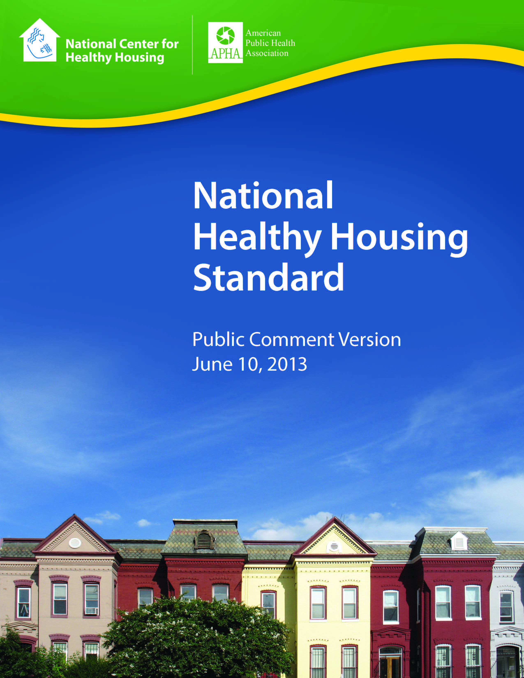
National Healthy Housing Standard

Slide 2
Timeline
Activity | Who | Deadline
Provide input, adopt strategy | National Committee on Housing and Health | October 2012
Prepare draft | NCHH Staff | December 2012
Technical review Reconcile with codes Literature review | Technical Review Work Group and NCHH Staff | December 2012 – May 2013
Public Comment Period | Interested Parties | June – July 2013
Review public comments and incorporate changes | Technical Review Work Group and NCHH Staff | September - November 2013
Endorsement of Standard | National Committee on Housing and Health | January 2014
Publication for Adoption May 2014
Notes:
Original timeline
National Committee on Housing and Health
Convened to review process (October)
Technical Review Work Group
Scientific review of provisions (November - January)
Review and incorporate comments (March/April)
Legal Issues Review – (December-January)
Stakeholder Engagement
Housing & federal agency leaders (Nov-Dec)
Public comment (February)
Dissemination (May)

Slide 3
Intent National Healthy Housing Standard
PUBLIC HEALTH PROTECTION
Health
Based
Attainable, Enforceable and Practicable
HOUSING AFFORDABILITY
Notes:
The National Healthy Housing Standard is an effort by the National Center for Healthy Housing and the American Public Health Association to improve housing conditions in the United States through the development of property maintenance policies that are reflective of modern public health concerns. Past attempts to incorporate health into housing standards have been met with modest success, mainly because the engagement and dissemination strategies focused solely on public health agencies. We plan to engage and disseminate information to both public health and housing organizations. We also expect that community-based organizations will have an important role in promoting the Standard. Ultimately, the success of the Standard hinges in large part, on the effectiveness of our stakeholder engagement and dissemination activities.

Slide 4
The Standard’s Value Add
Strengthen existing code
Adopt in entirety
Overlay IPMC
Guide rental property owner
Deliver standard of care for every home
Not a construction or rehab standard…
Notes:
The National Center for Healthy Housing (NCHH) and American Public Health Association (APHA) hope to elevate the likelihood that every U.S. family will live in a healthy home by developing an attainable, enforceable, evidence-based and practicable healthy housing standard suitable for adoption by local and state governments and federal agencies. The standard will inform and deliver housing policies that reflect the latest understanding of the connections between housing conditions and health. Its wide availability will enable agencies at all levels of government to enact policy that's effective in preventing disease and injury and improving health outcomes, while avoiding the confusion of state-by-state and community-by-community code development.

Slide 5
Comparison with Health and Safety in Existing Standards
Provision | International Property Maintenance Code | HUD’s Housing Quality Standards | National Healthy Housing Standard
CO Alarm |  |  | 
Integrated Pest Management |  |  | 
Ventilation |  |  | 
Noise Infiltration Limit |  |  | 
Correct Moisture Problem and Cause |  |  | 
Notes:
IPMC is the International Property Maintenance Code
HQS is HUD’s Housing Quality Standards

Slide 6

2014 Goal: Reach target organizations
Use social media, list-servs
Brief National Healthy Housing Training Center partners, National Safe and Healthy Housing Coalition members
Present at key conferences
Conduct media outreach – popular press, trades
Develop “hard news” story

Slide 7
Interface with ICC’s IPMC (International Property Maintenance Code)
Actions
Offer IPMC supplement to states and localities that use the IPMC
Promote NHHS w/IPMC
Support additions to the IPMC

Slide 8

Outcomes
Standard/overlay adoptions
Code changes
Strengthen financial institutions’ asset management
Enhance property maintenance results
Expanded public awareness and support for healthy housing

